Slide 1

Driving forces behind internet adoption
Nazim Ashman
Notes:
I am going to explore the driving forces behind internet adoption in different countries.

Slide 2
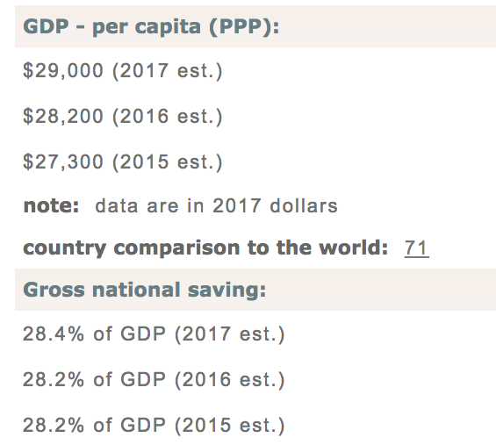
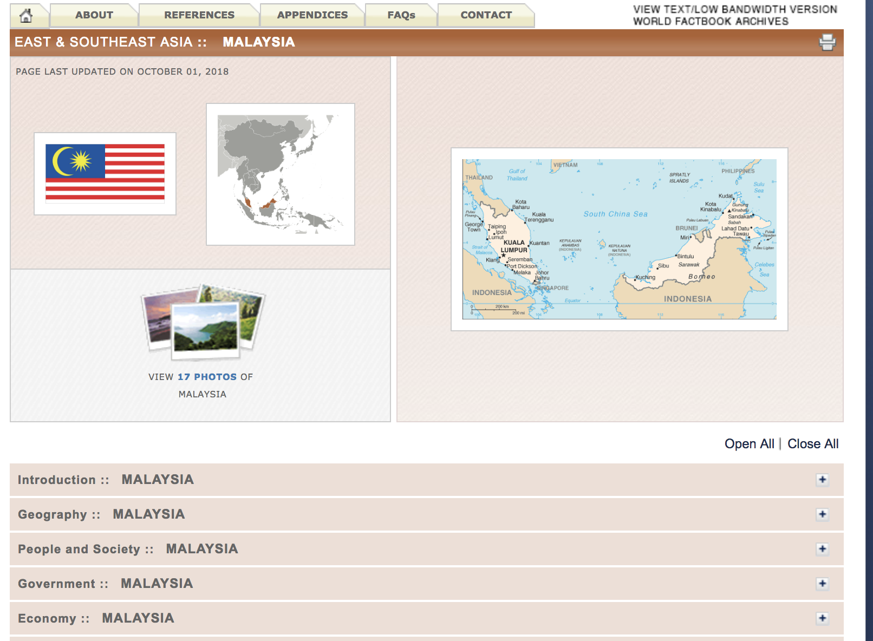
The Data
Source: CIA Worldfactbook
Notes:
I have gathered country data from CIA Worldfactbook. This website contains a variety of economic, societal and government data for different countries. I decided to focus on metrics that were easily available for a large number of countries to maximise the amount of data I had for modelling. This is because my dataset is quite small (200 something). Here is an example from one country.

Slide 3
Initial features and expectations
Features:
Economic: GDP per capita, unemployment rate, education expenditure, % of economy in agriculture, industry and services, public debt, exports and imports.
Notes:
Here are some initial economic metrics that I scraped. GDP per capita, unemployment rate etc. Here I expect more developed countries to have a higher internet userbase than lesser economically developed countries.

Slide 4
Initial features and expectations
Features:
Economic: GDP per capita, unemployment rate, education expenditure, % of economy in agriculture, industry and services, public debt, exports and imports.
Society: Population, Population below poverty, total telephones (cellular and landline), urbanization and internet users in bordering countries
Notes:
Here are some of the societal features that I gathered. Total telephones is an interesting one because I thought that a higher it represented the amount of connectivity in the country. And a strong communications infrastructure could mean better infrastructure for internet.
Another interesting feature is internet users in bordering countries. I expected countries geographically close to one another to have similar cultures and lifestyles and hence similar internet adoption rates.

Slide 5
Correlations
Notes:
The first piece of analysis I did was to look at the correlations between each feature and the number of internet users in the country.
Darker colors indicate a high correlation with internet users. Here we can see strong correlations for GDP per capita, Exports + imports, and % of GDP from agriculture among others.

Slide 6
P-values for all features
Feature | P>(t)
Education expenditure | 0.366
GDP per capita | 0.126
Population in Poverty | 0.001
Population | 0.324
Public Debt | 0.574
Unemployment Rate | 0.571
Urbanization | 0.098
% of GDP from Agriculture | 0.000
% of GDP from Industry | 0.005
Internet Users in Bordering Countries | 0.052
Exports + Imports | 0.777
Mobile + Landline device | 0.405
Notes:
To see whether these correlations translated into statistical significant outcomes in a model I looked at the p-values for a linear model fit using OLS.
The p-value shows the probability of getting a result as extreme as your by chance.
So low p-values show that the features are contributing to the model with statistical significance.

Slide 7
P-values for all features
Feature | P>(t)
Education expenditure | 0.366
GDP per capita | 0.126
Population in Poverty | 0.001
Population | 0.324
Public Debt | 0.574
Unemployment Rate | 0.571
Urbanization | 0.098
% of GDP from Agriculture | 0.000
% of GDP from Industry | 0.005
Internet Users in Bordering Countries | 0.052
Exports + Imports | 0.777
Mobile + Landline device | 0.405
Notes:
Green shows good p-value and red shows bad, so we should reject these features.
However, many features of the rejected features had high correlation and I expected them to have low p-values.

Slide 8
P-values for all features
Feature | P>(t)
Education expenditure | 0.366
GDP per capita | 0.126
Population in Poverty | 0.001
Population | 0.324
Public Debt | 0.574
Unemployment Rate | 0.571
Urbanization | 0.098
% of GDP from Agriculture | 0.000
% of GDP from Industry | 0.005
Internet Users in Bordering Countries | 0.052
Exports + Imports | 0.777
Mobile + Landline device | 0.405

Slide 9
Removing collinear features
Exports + Imports are redundant
Urbanization is redundant
Feature | P>(t)
GDP per capita | 0.000
Internet Users in Bordering Countries | 0.000
% of GDP from Agriculture | 0.000
Population in Poverty | 0.000
Notes:
After analysing the data further I inferred that exports + import were highly collinear with gdp per capita. Also found that urbanization and % of economy in agriculture were highly colinear. Colinear meaning that you can infer one by looking at the other.
After removing these features, we get acceptable p-values for all of the 4 remaining features.

Slide 10
Elastic net regularization: 2nd degree
R² of 0.76 on test set.
Final coefficients:
Feature | Coefficient
% GDP from Agriculture | 0.412
GDP per capita | 0.359
Population under poverty | 0.277
Internet users in bordering countries | 0.049
(Internet users in bordering countries)² | 0.201
Notes:
Finally, these features were fed into an elastic net linear model. A 2nd degree model was found to fit the data best.
Testting on the test data it was found that 76% of the variance in internet useres among countries could be explained by the model.
The final coefficients of the model suggest countries should focus on shifting their economies to more service and industry related sectors. These sectors involve larger amount of communication and internet technology.
As expected wealthier countries are likely to have a higher internet user base. All economies focus on improving their GDP and wider internet adoption is expected as an economy grows.
Not only is the total wealth of an economy integral, but the distribution of wealth proves to be an influential factor. Again, all countries focus on reducing poverty.
Finally, it can be seen that neighboring countries have an impact or correlation with internet users in a country. Neighboring countries are likely to have similar cultures and lifestyles which may be lead to high internet adoption. Here it is important to note that a squared relationship was found to fit best. This means that this feature is inlfuential at large levels but not in small levels. E.g if surrounding by high internet using countries, a country is likely to have high internet populatoin. But if surrounded by low internet countries, the effect is not as significant.

Slide 11
Conclusions
Low % of economy in agriculture.
Richer countries have higher internet base.
Overall living conditions.
Internet culture in neighboring countries.
Notes:
Countries which produce more in services and industry as oppposed to agriculture have a larger internet userbase. These industries require more of an internet presence also.
High agriculture also = high rural population and less urban, difficult to connect.
Richer countries have higher internet base. Richer countries can spend more on crucial infrastructure. Population have a higher income to spend on internet services.
Living standards in a country matter, countries with a higher amount above the poverty line have a higher internet userbase.
Neighboring countries may have a large internet culture. Cultures/lifestyles of neighboring countries are likely to be similar and hence their internet adoption patterns are likely to be similar.
Maybe find some examples.

